Slide 1
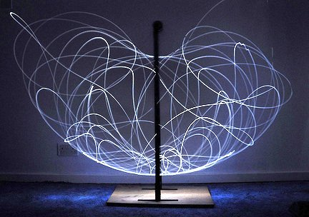
The Double/Triple Pendulum: Reinforcement Learning

Slide 2
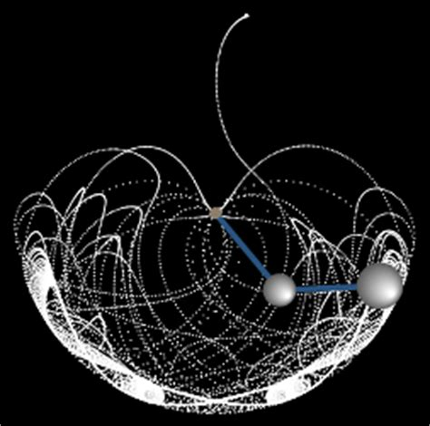
The Double Pendulum
Double pendulum has chaotic oscillations
Similar to n-body problem
Compared to simple pendulum, which has regular oscillations and swings back and forth

Slide 3
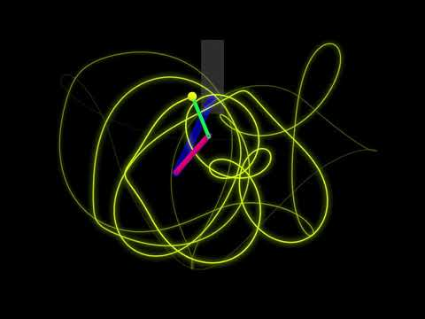
The Triple Pendulum
Chaotic
The math is way more complicated and long than then double pendulum
Can keep going (quadruple, quintuple, …)

Slide 4
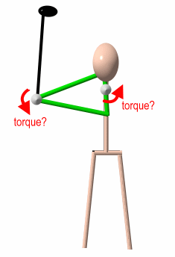
Real Life Examples
Normal human walking can be explained similar to a double pendulum
Circuits (overhead transmission lines) - anti-galloping devices with double pendulum
Tennis: both double and triple pendulums (double pendulum - forearm and racquet; triple pendulum - upper arm, forearm, racquet)
Notes:
https://www.sciencedirect.com/topics/engineering/double-pendulum
http://twu.tennis-warehouse.com/learning_center/doublependulum.php

Slide 5
Question:
How does the accuracy of a reinforcement learning model for a system with a triple pendulum compare to that of the double pendulum?

Slide 6

What Is Reinforcement Learning
Map situations to actions to maximize a numerical reward
Different algorithms/ways to do it
I used PILCO - Probabilistic Inference For Learning Control
Can solve problems with continuous action and state spaces

Slide 7
Why Did I Choose The Question?
I’ve been learning about reinforcement learning this summer
I was originally going to apply reinforcement learning to the n-body problem, but there wasn’t anything there to optimize
So I changed my topic to the double/triple pendulum

Slide 8
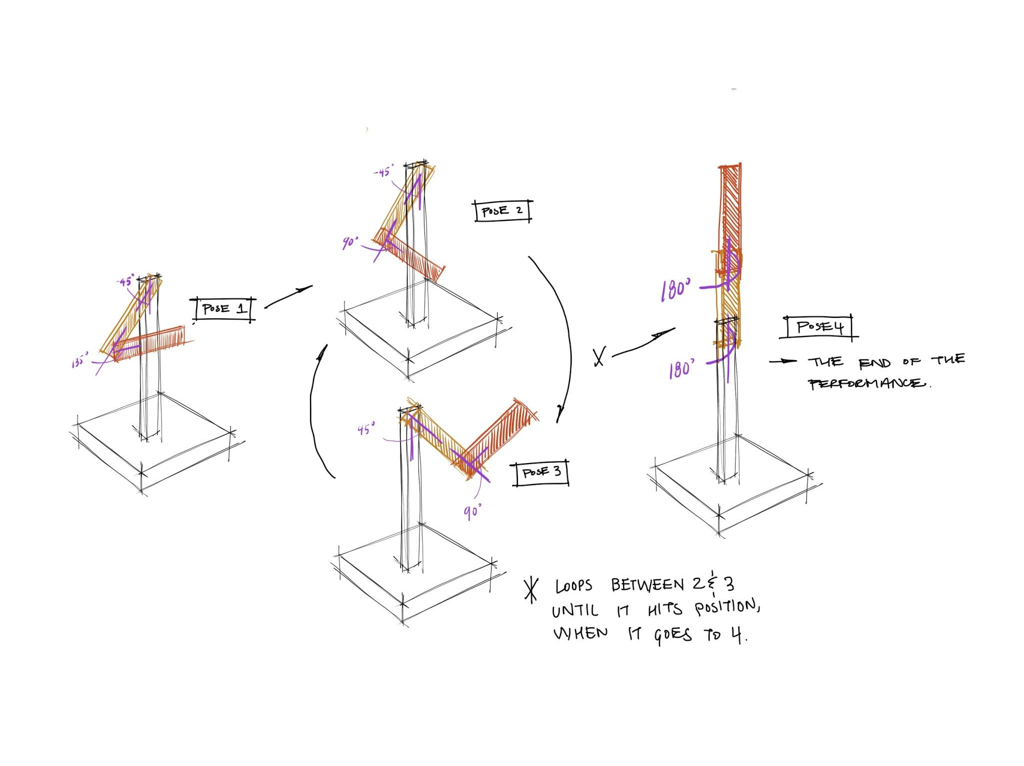
What’s the problem?
There is a double/triple pendulum where each joint exerts torque (rotational force)
The user controls how much torque is applied
The goal is to get the pendulum to be upright (unstable equilibrium position)
Build an algorithm that can apply the proper amount of torque to achieve the goal

Slide 9
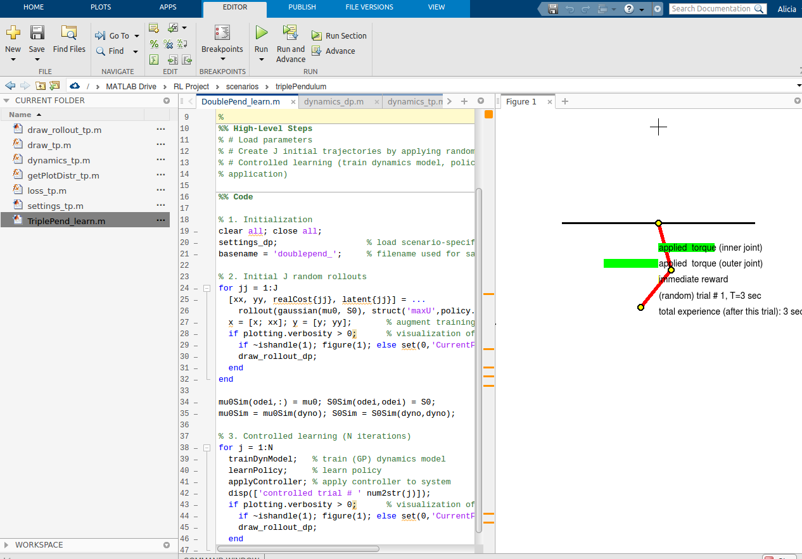
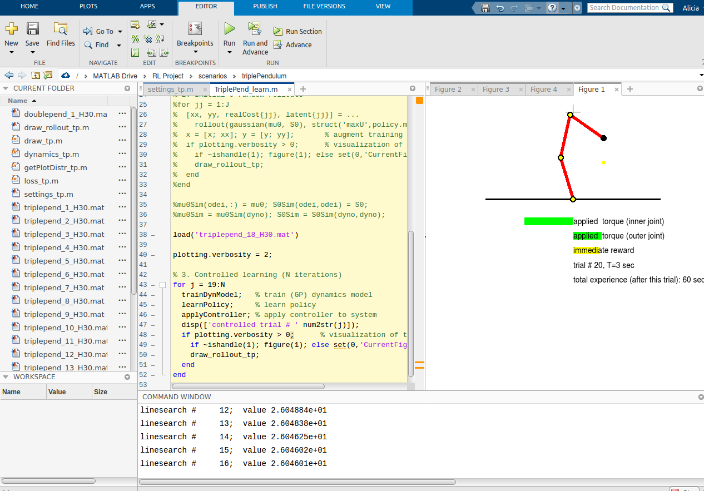
Double Pendulum
Triple Pendulum

Slide 10
What’s my hypothesis?
The model trained on the triple pendulum swing up problem will be less accurate than a model trained on the double pendulum swing up problem (it should need more time to train)
More variables + more math for triple pendulum
I also predict that as the number of joints of the pendulum increase, the training time to achieve the same amount of accuracy should go up exponentially

Slide 11
Steps Of The Experiment
Make simulation for triple pendulum and update the settings
Run double pendulum code (example code in PILCO package)
Run triple pendulum code
Compare

Slide 12
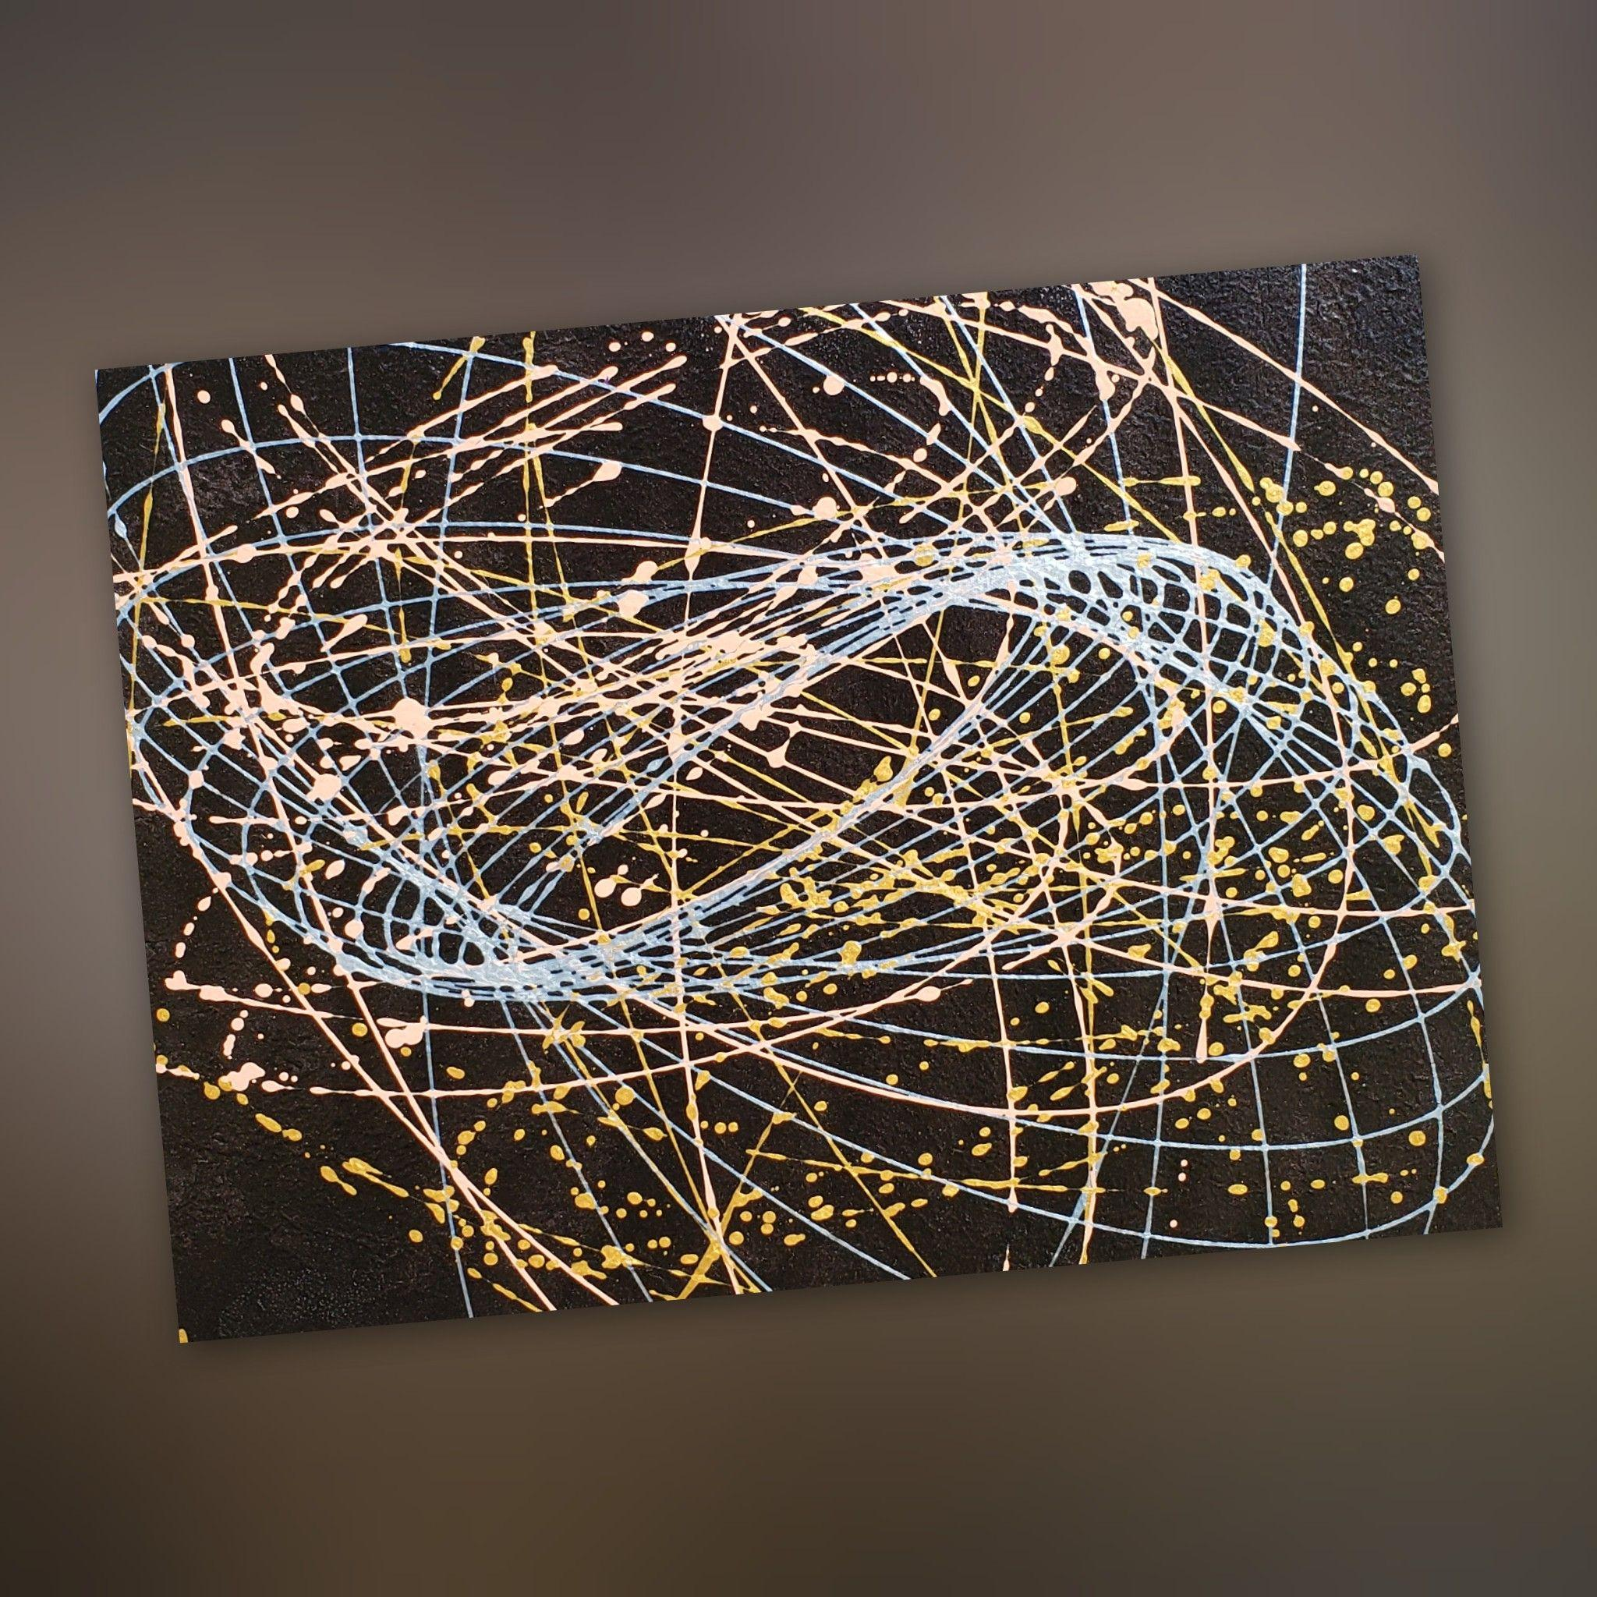
Comparison

Slide 13
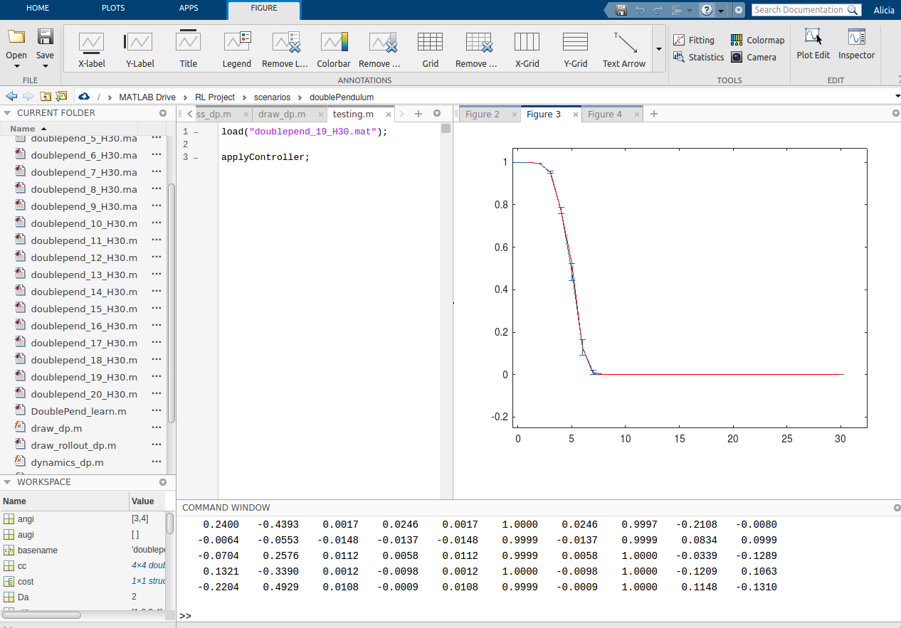
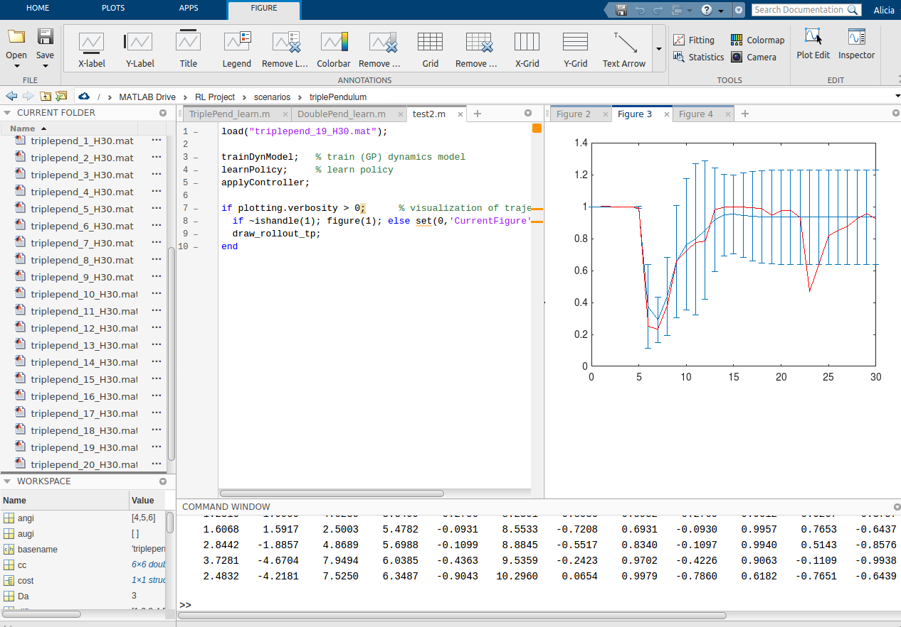
Predicted Cost vs Incurred Cost
Blue (95% confidence for predicted cost) and red areas (incurred cost) should be the same
Double Pendulum
Triple Pendulum

Slide 14
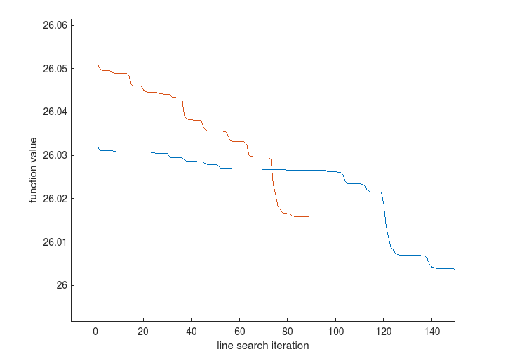
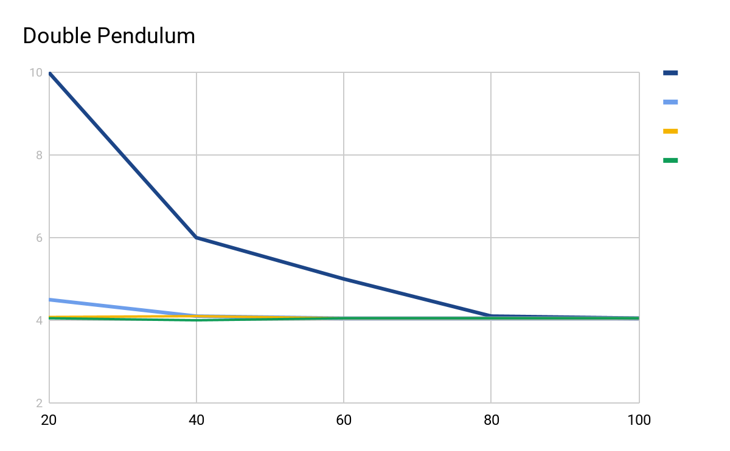
Policy Convergence
Curve should flatten out
Triple Pendulum
I didn’t save the graph for the double pendulum but it converged… it looked like this

Slide 15
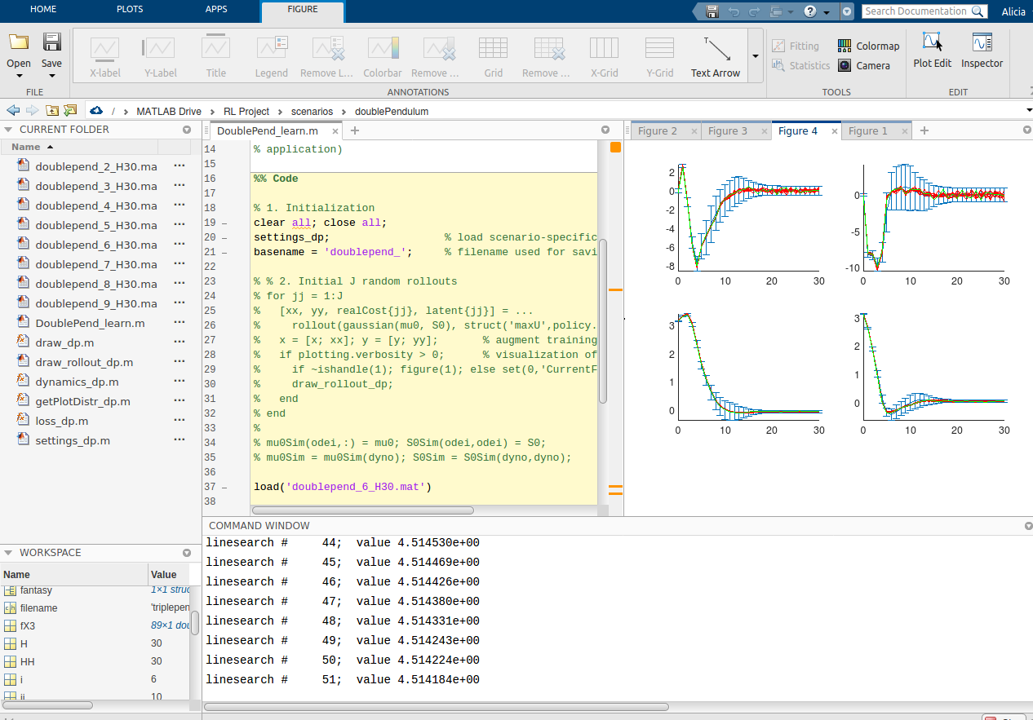
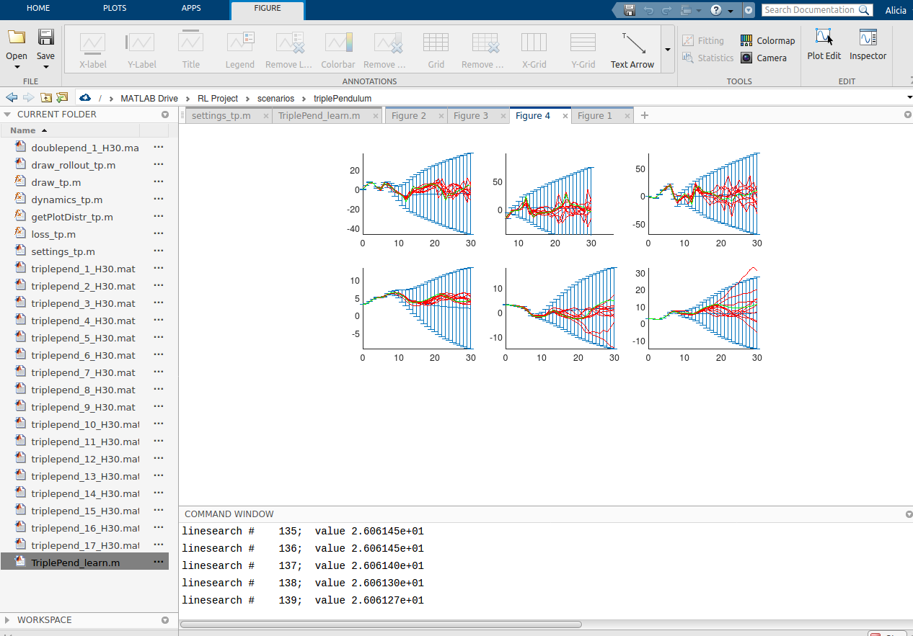
State trajectories for each dimension
Blue area represents 95% confidence intervals
Triple Pendulum
Double Pendulum
Notes:
For each predictive dimension, 10 possible state trajectories are displayed based on the policy.

Slide 16
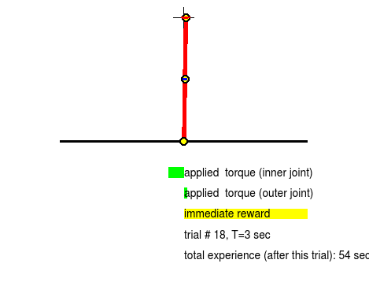
Final Pendulum Position
Double Pendulum
Triple Pendulum

Slide 17
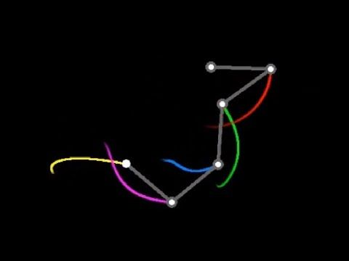
Extensions
See how many iterations are needed so that the triple pendulum policy converges
See what happens for more complex pendulums (quadruple pendulum, quintuple pendulum… etc.)
Can run with real system (not just computer simulation)

Slide 18

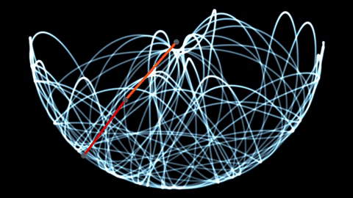
THANKS!

Slide 19
CREDITS
Special thanks to all the people who made and released these awesome resources for free:
Presentation template by SlidesCarnival
Photographs by Unsplash

